Slide 1

VW IE H2 2020 -
Always On Offer Testing

Slide 2


Ads with the % APR messaging included, were 33% more effective at driving completed conversions vs ads with only the monthly price.
Offer Messaging Performance per Model
Example of Monthly Price vs Monthly Price & 0% APR Messaging
Price per Month
Price per Month & 0% APR
Overview
This creative test ran across 7 models displaying the price of the model per month vs 0% APR. The aim of the test was to identify if 0% APR was important in influencing consumers to act.
Findings
The impact on CTR was minimal across the models however, conversion rates were consistently greater across models when the ad included the APR messaging*.
This indicates the 0% offer is significant in influencing consumer consideration and pushing them further down the consumer funnel.
Conversions
CTR % | 0.13% | 0.12% | 0.11% | 0.12% | 0.15% | 0.15% | 0.12% | 0.11%
CVR % | 0.008 % | 0.004 % | 0.019% | 0.014% | 0.024% | 0.019% | 0.006% | 0.003%
*Across models where the data was statistically significant
Date – 13.08 – 13.09.2020
Conversion - Start Configurations

Slide 3


Ads with both % APR and Monthly Price messaging, were 46% more effective at driving completed conversions vs ads with only the APR %.
Example of Monthly Price vs Monthly Price & 0% APR Messaging
0% APR Messaging
APR & Monthly Price Messaging
Overview
This test ran as an extension of the Q3 test across Golf and Passat, with the aim of identifying whether price per month messaging is important in a consumer's decision to act. Offer messaging this time displayed 0% APR vs 0% APR and monthly price.
Findings
The impact on CTR again was minimal across both models however, conversions were greater when the ad showed both the 0% APR and monthly price messaging.
 |  | No. Impressions | No. Clicks | Config Start | CTR % | CVR %
Overall | APR | 365,469 | 667 | 129 | 0.18% | 0.04%
 | APR & Monthly Price | 361,085 | 684 | 187 | 0.19% | 0.05%
Golf 8 | APR | 231,428 | 113 | 327 | 0.05% | 0.14%
 | APR & Monthly Price | 227,493 | 164 | 338 | 0.07% | 0.15%
Passat | APR | 134,041 | 16 | 340 | 0.01% | 0.25%
 | APR & Monthly Price | 133,592 | 23 | 346 | 0.02% | 0.26%
Date – 31.10 – 31.12.2020
Conversion - Start Configurations
Notes:
Ads with APR messaging was 33% more effective at driving conversions resulting in 575 euros saved in achieving campaign goals.

Slide 4
Overall, optimisations were 38% more effective at driving completed conversions, resulting in a 27% average CPL reduction.
A/B Testing Finance Creative
Insights drove improved results
CONVERSIONS INCREASED BY
REDUCED AVERAGE CPL
Test 1
38%
27%
Price per Month
Price per Month & 0% APR
Ads with the % APR and price per month messaging were 38% more effective at driving completed conversions.
After optimising to the monthly price with 0% offer, we were able to reduce average CPL by 27%
Insight
These findings, indicate that both components of the offer are important in influencing a consumer to act.
They suggest providing greater financial information within the ad pushes drives consumers further down the funnel due to having knowledge of the full offer prior to website visits.
Test 2
0% APR Messaging
APR & Monthly Price Messaging
Ireland, 13/08/2020 – 13/09/2020, Conversions – SIZMEK Adserver Data, and Cost calculations – DSP data (DBM) Ave. for period.

Slide 5
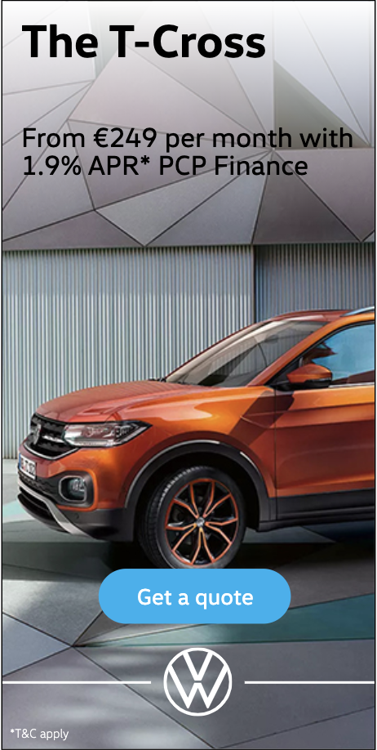
Future Testing Opportunities
Other Considerations
Findings from these tests could be directly linked to the fact that the offer was 0% APR.
This in combination with price per month is explicit easy to understand.
Price per month is a tangible number the consumer can use to work out affordability and 0% APR contributes to this.
Future Testing
It may be that when the APR is higher than 0% the message is harder to understand and therefore may not be as important to the consumer.
Future testing could include a combination of higher APR % and price per month messaging vs price per month to determine if APR % is still relevant when above 0%.
Notes:
Tests across VW Group see similar results for 0% but above that needs further understanding

Slide 6
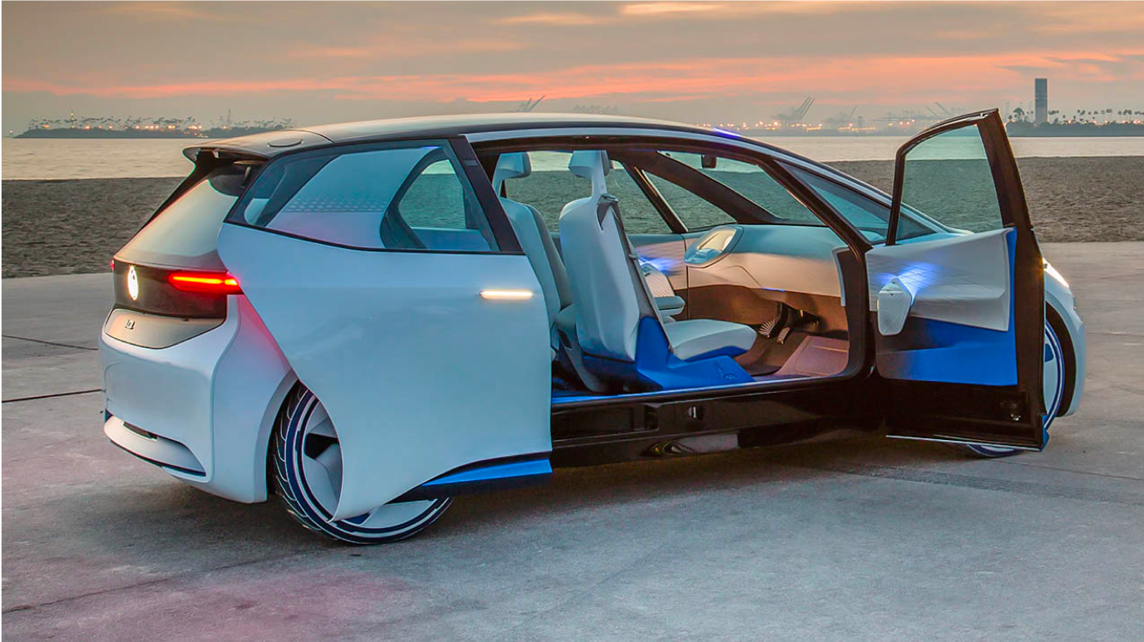

Appendix

Slide 7
Appendix – Q3 Monthly Price vs Monthly Price & APR Data detailed
Per Model Comparison
Model | VW Test | Impressions | CTR | CVR | Clicks | Total Conversions
Arteon | Monthly Price | 530,495 | 0.12 % | 0.004 % | 647 | 21
Arteon | Monthly Price & 0% APR | 529,430 | 0.13 % | 0.008 % | 691 | 42
Passat GTE | Monthly Price | 446,648 | 0.11 % | 0.003 % | 502 | 15
Passat GTE | Monthly Price & 0% APR | 447,657 | 0.11 % | 0.006 % | 474 | 28
E-Golf | Monthly Price | 430,689 | 0.12 % | 0.014 % | 500 | 62
E-Golf | Monthly Price & 0% APR | 430,511 | 0.11 % | 0.019 % | 480 | 82
Golf 8 | Monthly Price | 302,047 | 0.15 % | 0.019 % | 441 | 58
Golf 8 | Monthly Price & 0% APR | 302,410 | 0.15 % | 0.024 % | 446 | 73
Tiguan Allspace | Monthly Price | 176,537 | 0.12 % | 0.011 % | 220 | 19
Tiguan Allspace | Monthly Price & 0% APR | 176,225 | 0.13 % | 0.009 % | 222 | 15
Passat | Monthly Price | 38,304 | 0.29 % | 0.016 % | 112 | 6
Passat | Monthly Price & 0% APR | 38,310 | 0.27 % | 0.013 % | 105 | 5
Tiguan | Monthly Price | 23,416 | 0.23 % | 0.030 % | 53 | 7
Tiguan | Monthly Price & 0% APR | 23,427 | 0.34 % | 0.017 % | 79 | 4
Date – 13.08 – 13.09.2020
Conversion - Start Configurations

